Slide 1
Refactoring 101
Sean Chambers

Slide 2
Some Infoz
Blog
http://schambers.lostechies.com (31 Days of Refactoring) Twitter
schambers
Sample Code & Presentation
http://www.github.com/schambers/refactoring-101 Resources
http://www.refactoring.com

Slide 3
Martin Fowler states
“The process of changing a software system in such a way that it does not alter the external behavior of the code yet improves its internal structure."
http://www.refactoring.com

Slide 4


Slide 5
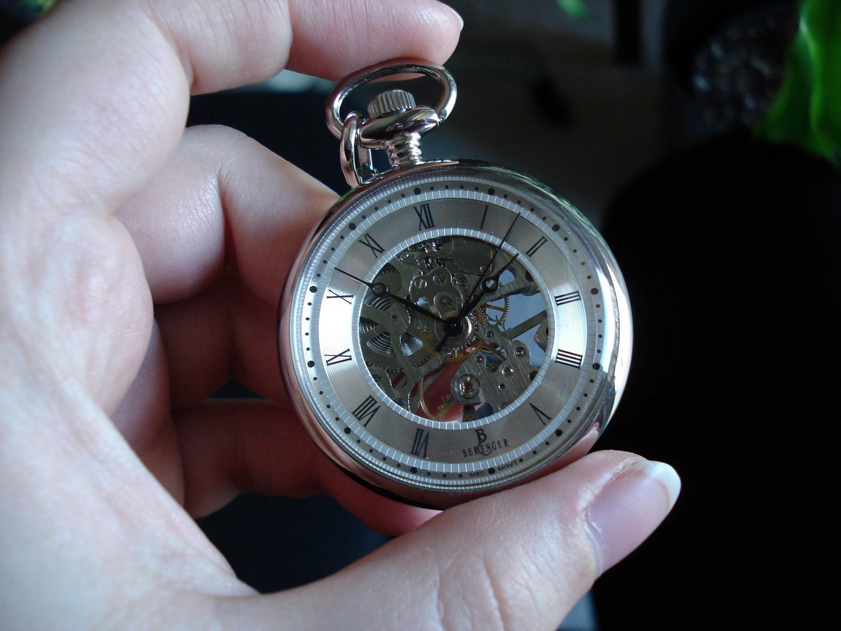

Slide 6


Slide 7
Refactoring Samples

Slide 8
Questions?
Blog
http://schambers.lostechies.com (31 Days of Refactoring) Twitter
schambers
Sample Code & Presentation
http://www.github.com/schambers/refactoring-101 Resources
http://www.refactoring.com
Working Effectively with Legacy Code (Michael Feathers)

Slide 9
Sean Chambers
http://schambers.lostechies.com
Twitter: schambers
http://www.refactoring.com
Working Effectively with Legacy Code (Michael Feathers)
Sample Code
http://www.github.com/schambers/refactoring-101/zipball/master

